Slide 1
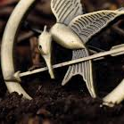
The dystopian characteristics of the hunger games
The Final Presentation:
By: Christina Thomas

Slide 2
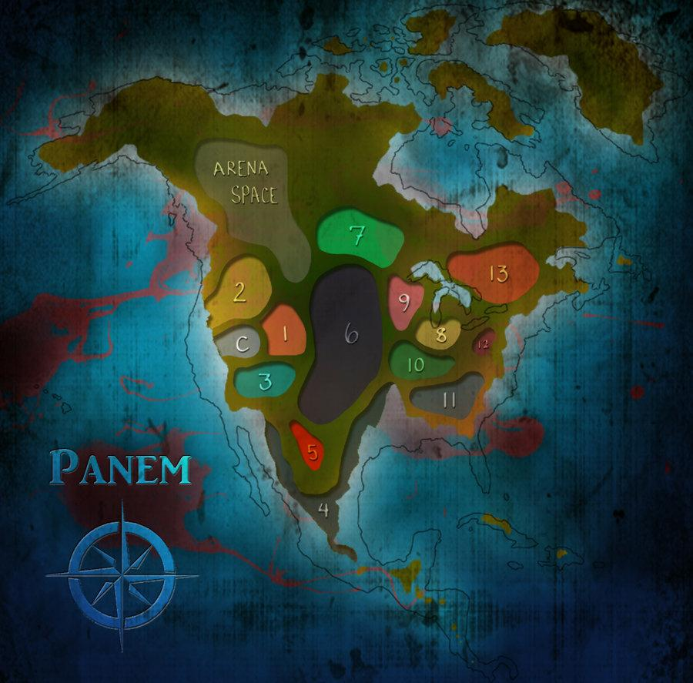

Thesis:
The citizens of Panem are being controlled by their corrupt government that openly displays its dystopian characteristics; surveillance, dehumanization, and isolation.

Slide 3

A short Description of the novel
The Hunger Games, was created by the government to demonstrate the Capitol’s control over its states. The concept of The Hunger Games is enforced by the government because the government not only lotteries off each district a male and a female child from the ages 12 to 18 from each district, but they take the chosen children from their families and force them into Arena. The arena is a blanket of death that is televised nationally throughout Panem; only one Victor can win.

Slide 4
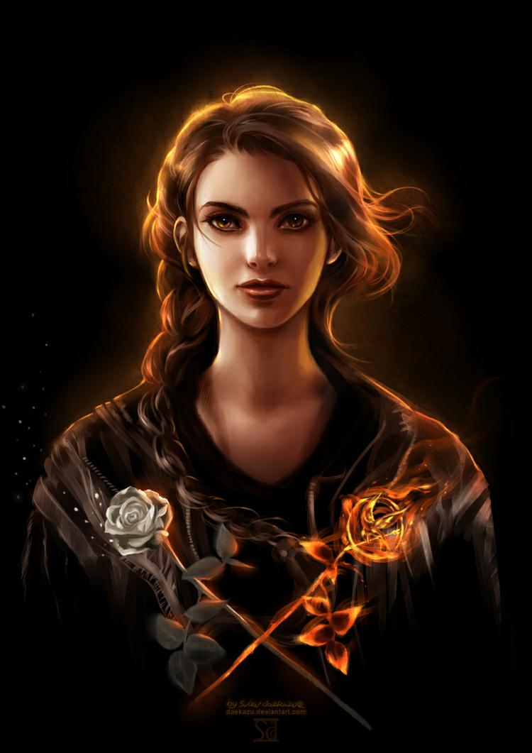
A main idea from one body paragraph : Surveillance
The first dystopian characteristic of the Panem nation is surveillance. The paranoia is real; privacy is stripped away as another means of preventing a rebellion

Slide 5
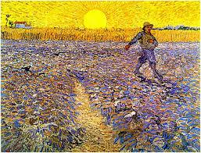
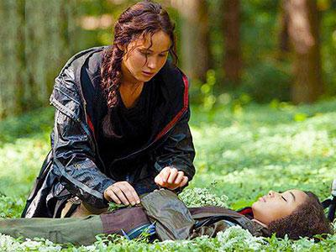
Relate to the text parable of the sower
Parable of the Sower
Example from text: "There was no house. There were no buildings. There was almost nothing: a board black smear on the hillside; a few charred planks sticking up from the rubble, some leaning against others; and a tall brick chimney, standing black and solitary like a tombstone in a picture of an old-style graveyard. A tombstone amid the bones and ashes" (pg. 314).
Dystopian characteristic
Both dystopian societies experience dehumanization:
The Hunger Games
Example from my essay:
"the Capitol dehumanizes its citizens by publicizing their children's death as reality entertainment."

Slide 6
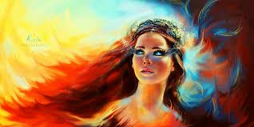

Something I learned during the writing process:
I learned that it was difficult to research sourceS that sololy focus upon the first book The Hunger Games.

Slide 7

questions
Did you all notice any other dystopian characteristics of The Hunger Games?
Are there any questions on the powerpoint?

